Slide 1
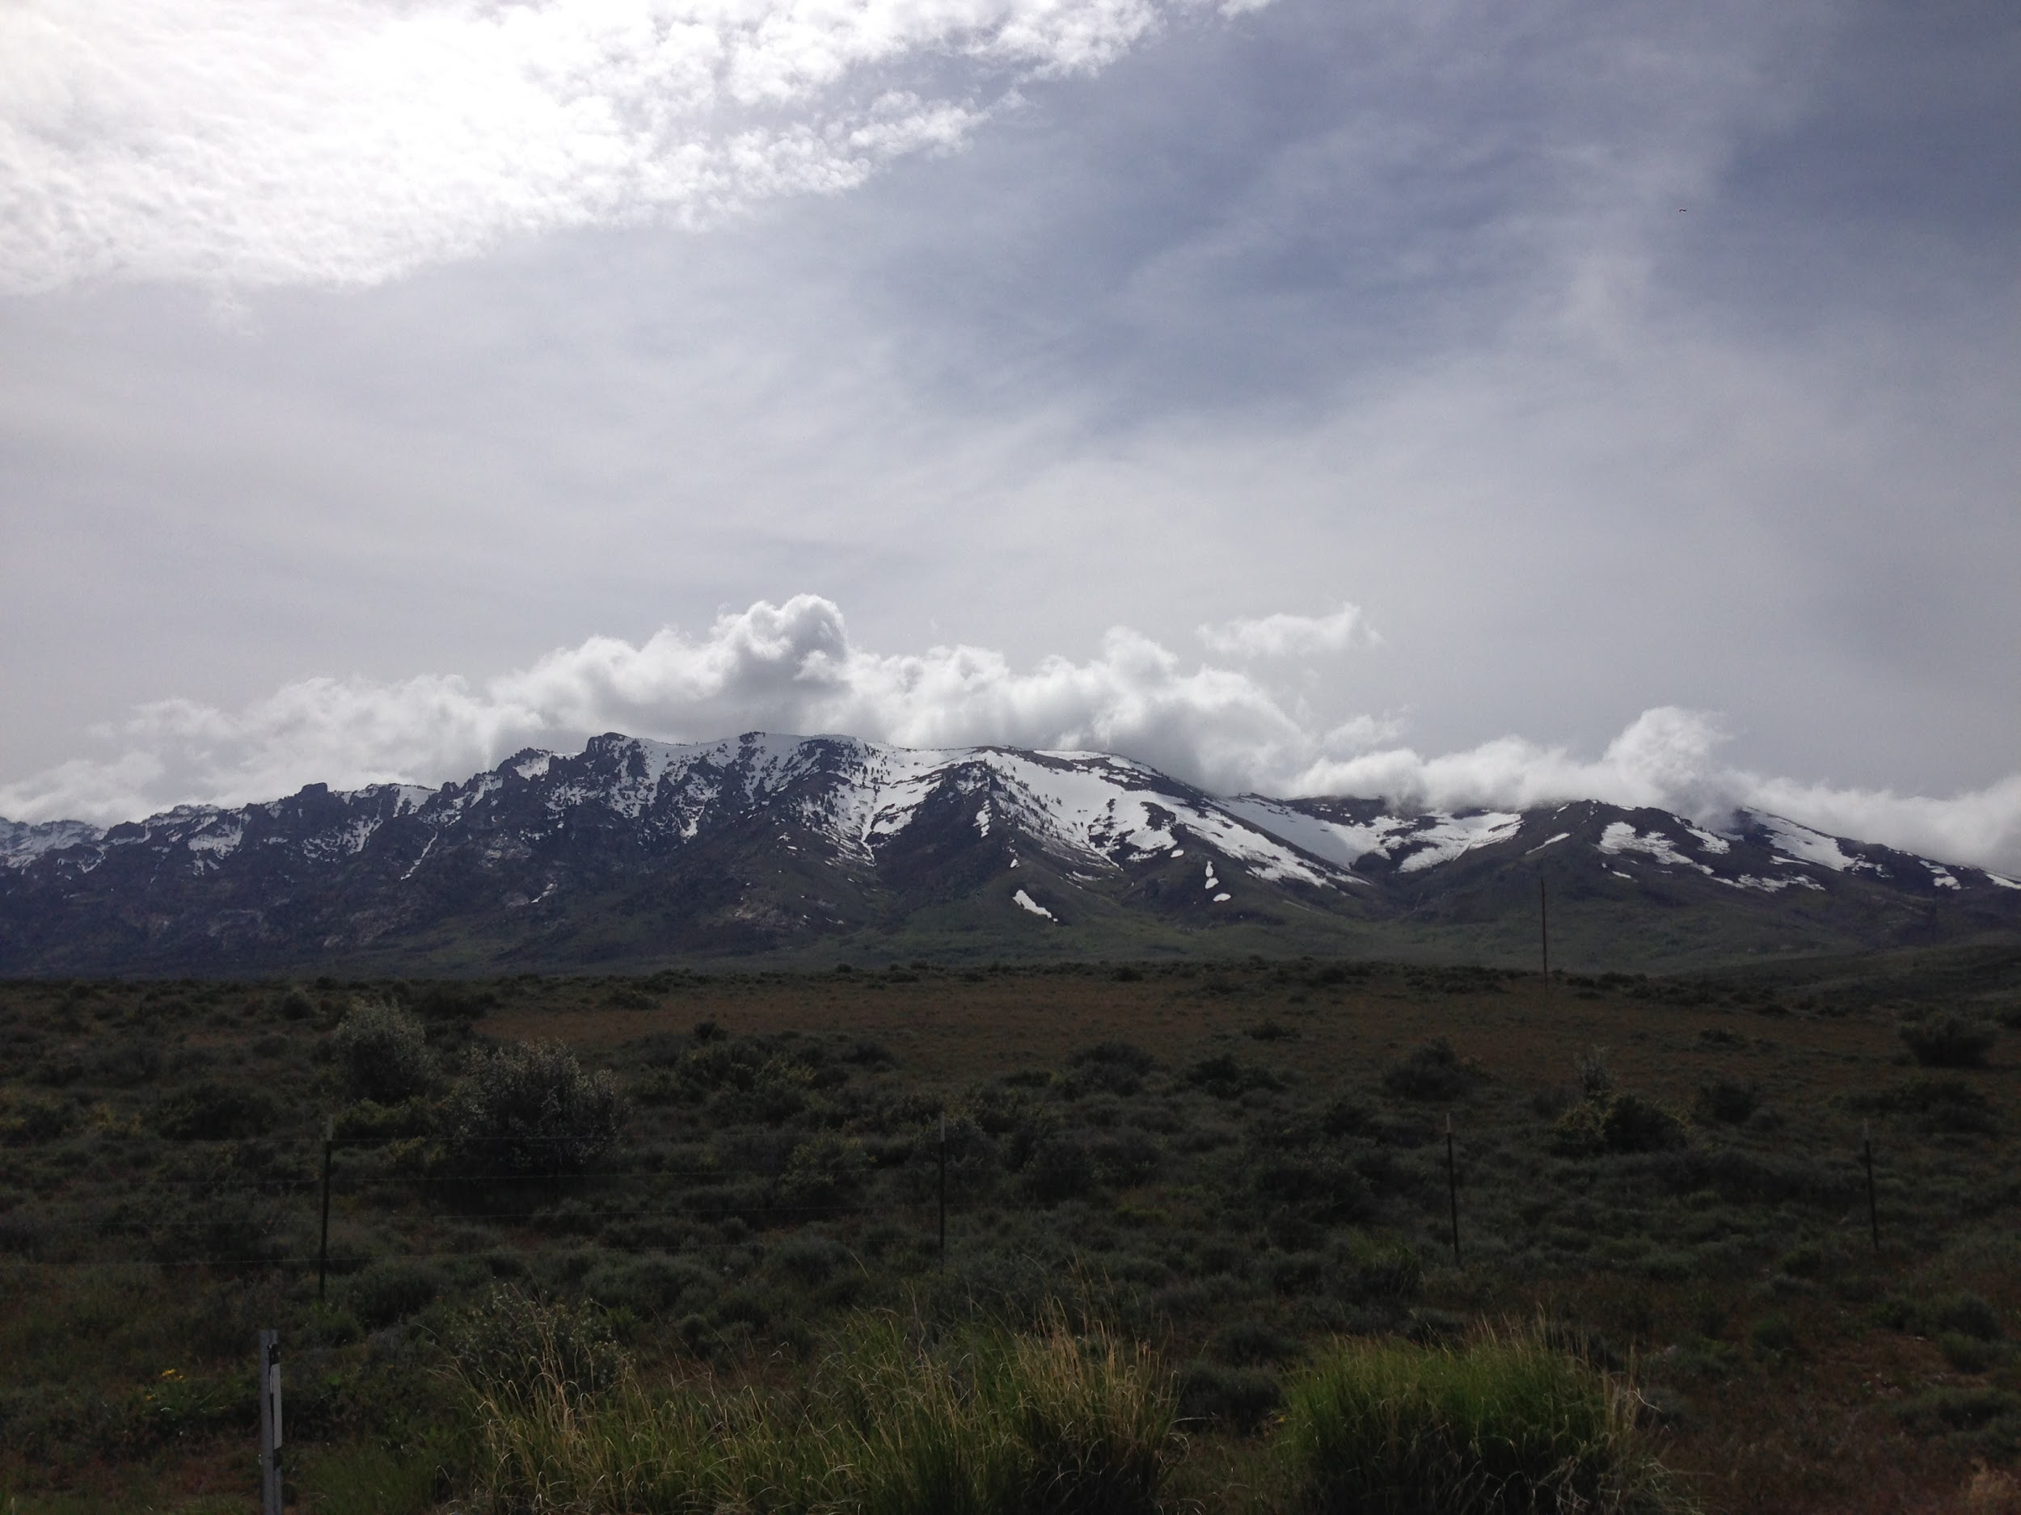



Mapping Crustal Deformation Using Seismic Anisotropy in Ruby Mountains, Nevada
Sarah Nolt-Caraway
Mentor: Dr. Ryan Porter
Northern Arizona University

Slide 2
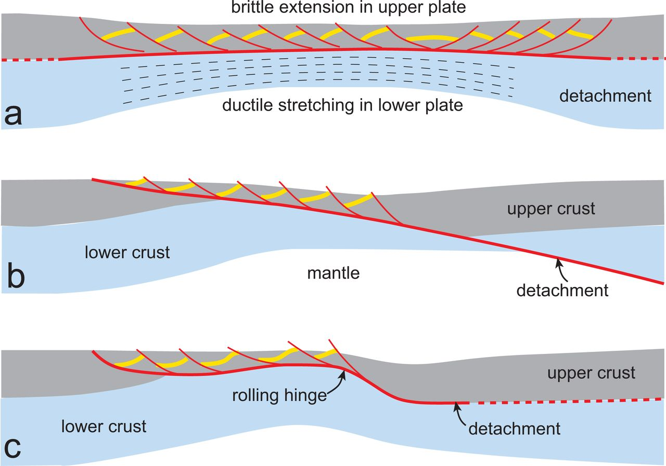
Metamorphic Core Complexes (MCCs)
Mountain Ranges formed due to large-scale extension of the crust.
Involves brittle and plastic deformation
(Platt, et all., 2014)
Notes:
Exhumed exposures of deep crust by regional extension
High grade metamorphic rocks are exposed at these sites
Ductile deformation anisotropic fabric

Slide 3
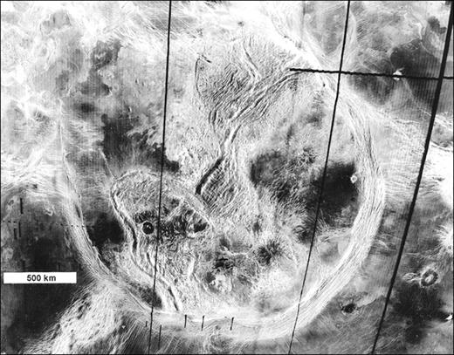
Scientific Importance
Planetary significance in understanding Metamorphic Core Complex
Understand how landscapes on earth evolve
Scientific community does not have clear consensus on what Metamorphic Core Complexes are
SAR Image of Artemis Corona, Venus (Spencer, 2001)

Slide 4
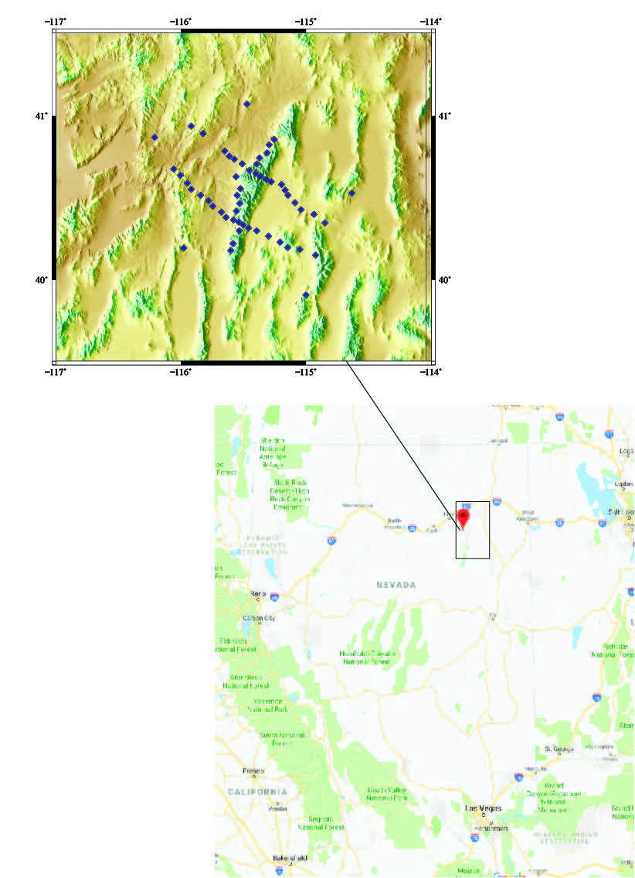
How is extension accommodated in the Earth’s crust?
Use publicly-available seismic data to image the crustal structure of the Ruby Mountains Metamorphic Core Complex, Nevada
Notes:
Add an image of Ruby Mountains with positions of data points. Come talk to me and lets update this figure

Slide 5
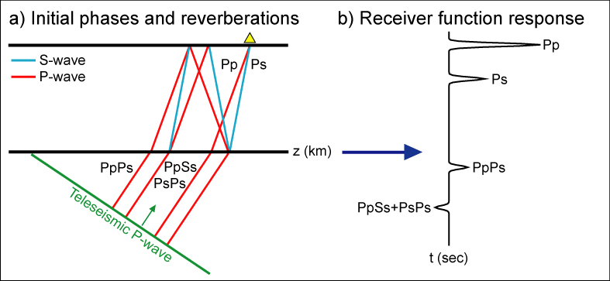
Receiver Functions
Uses teleseismic earthquakes recorded at a three component seismograph
An incoming P-wave will produce a refracted P-wave and a refracted S-wave
Image velocity contrast in the Earth, such as the Moho
Teleseismic
Notes:
Add figure

Slide 6
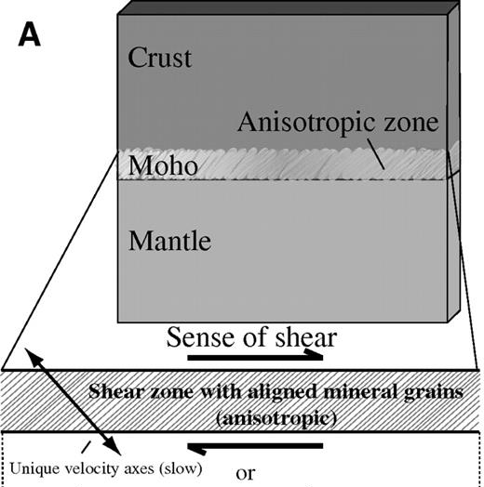
Seismic Anisotropy
Is the directional dependence of seismic velocity within a rock
Commonly associated with aligned mineral fabrics
Can be used as a proxy for deformation (strain) within the earth
Porter, et al., 2011

Slide 7
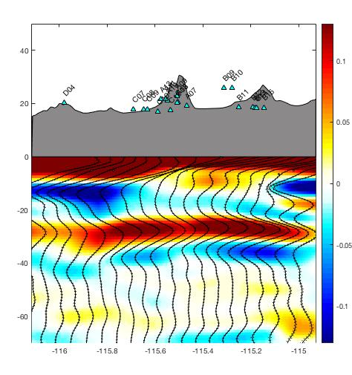
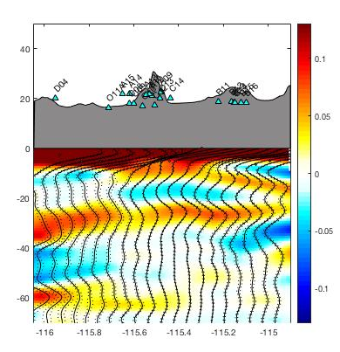
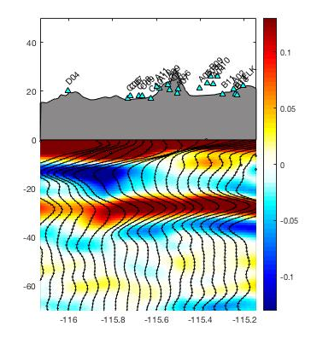
Analysis
0-360
0-180
180-360
Notes:
Where deformation is concentrated

Slide 8
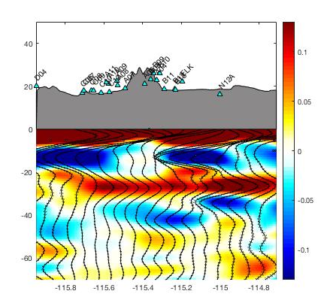
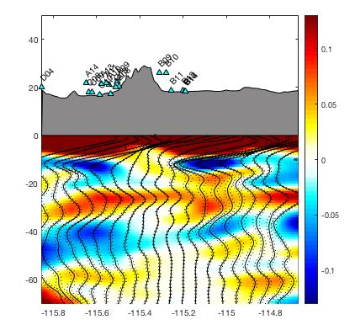
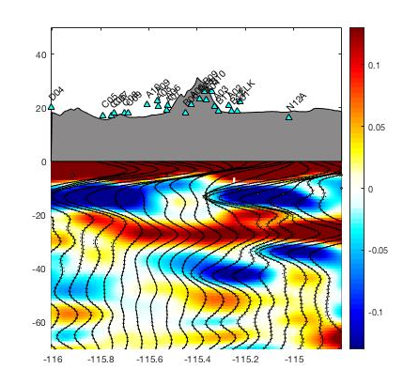
Analysis Cont.
0-360
0-180
180-360

Slide 9
Conclusion
Strong anisotropic fabric is present within the lower crust beneath this MCC
This contrasts many previous models of extension which argue for localized strain within the upper crust
Further analysis will be conducted for a publication

Slide 10

Acknowledgments
Northern Arizona University
Dr. Ryan Porter
NASA Space Grant
Dr. Nadine Barlow
Kathleen Stigmon

